Slide 1



Literature Review
Postgraduate Diploma in
Development Finance – Research Orientation
Dr Pieter Opperman

Slide 2
LITERATURE REVIEW
Conceptual definition…see Jamali (2004)
Theoretical framework
What is the science behind the phenomenon?
Transmission mechanism? ΔX⇒↑X⇒Y↓
Empirical literature
Where have studies been conducted?
What are the findings?
Methodology used?
Plagiarism (see Referencing slides)

Slide 3
IMPORTANCE OF THE LITERATURE REVIEW
Provide a researcher with important facts and background information about the subject under study;
Enables a researcher to avoid duplicating previous research;
Provides information about aspects of the problem which have not been investigated or explored before (the gaps);
Help a research to develop various parts of the study;

Slide 4
IMPORTANCE OF THE LITERATURE REVIEW
Provides insight regarding the weaknesses and problems of previous studies;
Provides ideas on how to proceed with the investigation;
Where relevant, it provides the basis for determining variable relationship, types of relationship and measurement;
Findings and conclusions of past studies can be accessed which can be related to own findings and conclusions;
Provides motivation for a study.

Slide 5
WHAT IS THEORY?
Theory is a statement (with explanation) predicting which action will lead to what results and why.
Theory is a set of systematically related statements (with explanation) that can be tested empirically.

Slide 6
THEORY: FURTHER OBSERVATIONS
Social theory attempts to discuss and explain what is, not what should be. Theory should not be confused with philosophy or belief.
Social science looks for regularities in social life.
Remember the importance of clearly defining the unit of analysis, Individual versus Aggregates.
Theories are written in the language of variables.
A variable is a logical set of attributes. An attribute is a characteristic. Gender, for example, is a variable made up of the attributes male and female.
In causal explanation, the presumed cause is the explanatory variable, and the affected variable is the dependent variable.

Slide 7
THEORETICAL FRAMEWORK – AN ILLUSTRATION (1)
FINANCE-GROWTH NEXUS
The genesis of the debate:
Robinson (1952:86) famously argued that "where enterprise leads finance follows." From this perspective, finance does not cause growth; finance responds to changing demands from the “real sector.”
At the other extreme, Miller (1988:14) argued that, “[the idea] that financial markets contribute to economic growth is a proposition too obvious for serious discussion.”
Drawing a more restrained conclusion, Bagehot (1873), Schumpeter (1912), Gurley and Shaw (1955), Goldsmith (1969), and McKinnon (1973) rejected the idea that the finance-growth nexus can be safely ignored without substantially limiting our understanding of economic growth.

Slide 8
THEORETICAL FRAMEWORK – AN ILLUSTRATION (1) (CONTINUED)
In recent times:
“A growing body of empirical analyses . . . demonstrate a strong positive link between the functioning of the financial system and long-run economic growth. Theory and evidence make it difficult to conclude that the financial system merely–and automatically–responds to industrialization and economic activity, or that financial development is an inconsequential addendum to the process of economic growth” (Levine, 1997:720).
However there are still concerns as Andersen et al. (2012) conclude that the finance–growth thesis stands challenged.

Slide 9
THEORETICAL FRAMEWORK – AN ILLUSTRATION (1) (CONTINUED)
Back to basics:
Schumpeter’s (1912:74) view of finance in the process of economic development:
The banker, therefore, is not so much primarily a middleman … He authorizes people in the name of society … (to innovate).
Smith on finance reducing cost & inducing specialization (Smith, 1776:3). With specialization
Men are much more likely to discover easier and readier methods of attaining any object, when the whole attention of their minds is directed towards that single object, than when it is dissipated among a great variety of things

Slide 10
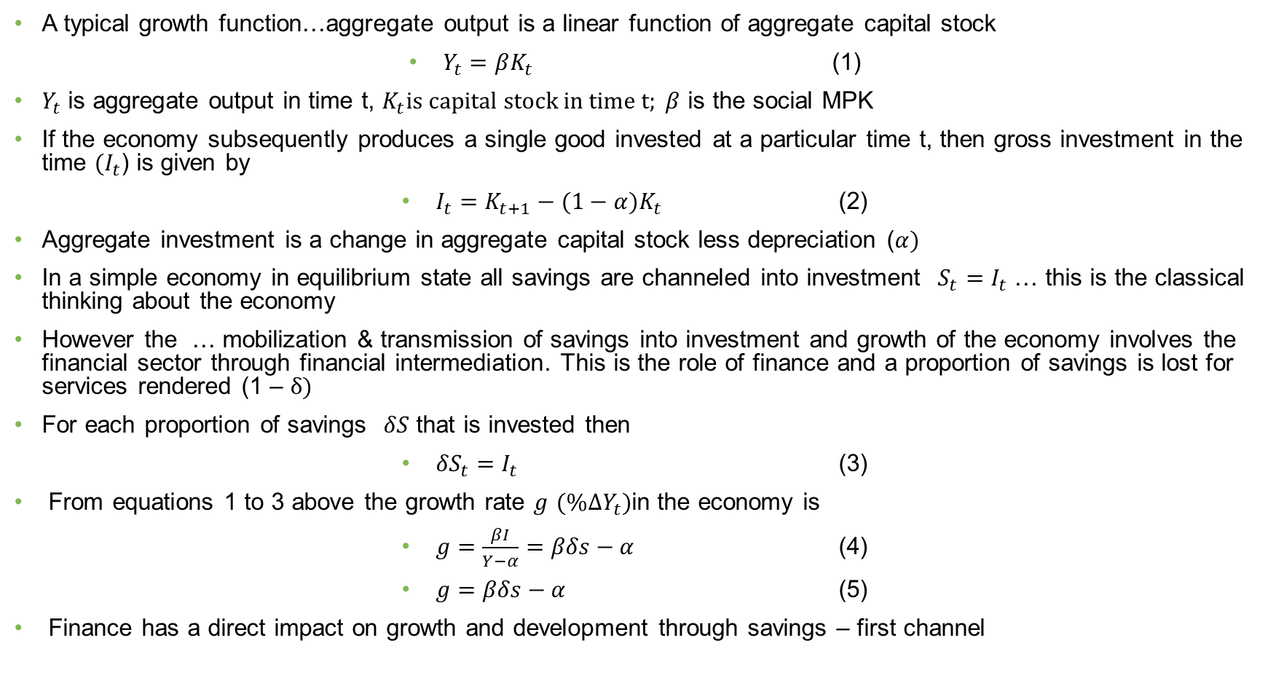
Theoretical link between finance and growth… Pagano (1993)
A typical growth function…aggregate output is a linear function of aggregate capital stock
$Y_{t}=βK_{t}$ (1)
$Y_{t}$ is aggregate output in time t, $K_{t}is capital stock in time t; β$ is the social MPK
If the economy subsequently produces a single good invested at a particular time t, then gross investment in the time ${(I}_{t}$) is given by
$I_{t}=K_{t+1}−(1−α)K_{t}$ (2)
Aggregate investment is a change in aggregate capital stock less depreciation ($α)$
In a simple economy in equilibrium state all savings are channeled into investment $S_{t}=I_{t}$ … this is the classical thinking about the economy
However the … mobilization & transmission of savings into investment and growth of the economy involves the financial sector through financial intermediation. This is the role of finance and a proportion of savings is lost for services rendered (1 – δ)
For each proportion of savings $δS$ that is invested then
${δS}_{t}=I_{t}$ (3)
From equations 1 to 3 above the growth rate $g$ $(\%∆Y_{t})$in the economy is
$g=\frac{βI}{Y−α}=βδs−α$ (4)
$g=βδs−α$ (5)
Finance has a direct impact on growth and development through savings – first channel

Slide 11
Finance-Growth Nexus
Finance drives growth and development through the following channels:
1. The first channel involves the efficient allocation of savings to investment.
As banks increase their intermediary role, they are likely to become more efficient with the spread between their lending and borrowing rates decreasing. The proportion of savings channeled to investment will increase, hence, g will increase as a result of an increase in δ
2. The second channel involves improving the allocation of capital.
As banks increase their intermediary role, they are likely to gain experience in evaluating alternative investment projects. Banks will also be able to channel a greater portion of funds to projects where the marginal product of capital is higher because of banks’ increased risk-sharing expertise.

Slide 12
THEORETICAL FRAMEWORK – AN ILLUSTRATION (2)
The theoretical literature suggests that the link between financial openness and output volatility is a priori unclear (Hwang et al., 2013; Meller, 2013). Increasing financial openness could reduce macroeconomic volatility in capital-poor developing economies by providing additional sources of external finance (Kose et al., 2006). Developing economies would then be able to diversify away from limited production bases that are often agricultural or natural resource dependent, thus lowering output volatility (Kose et al., 2009). Increased financial openness may also promote institutional reforms leading to a stable financial system, thereby contributing to output stability (Mishkin, 2009).

Slide 13
THEORETICAL FRAMEWORK – AN ILLUSTRATION (2)
Financial openness could also increase output volatility. Increased capital market integration could result in increased specialization (Kalemli-Ozcan et al., 2003). At a more advanced stage of development, middle-income countries could subsequently become more vulnerable to industry-specific shocks resulting in higher output volatility. If increasing capital market integration results in an over-reliance on external debt, countries will be exposed to world interest rate shocks and thus higher output volatility (Kose et al., 2009).

Slide 14
CONTEXTS FOR LITERATURE REVIEW
Contexts:
› It can be an end in itself (Aziakpono, 2011)
› A preliminary stage in a larger research project
› A component of a finished research report
In all cases: do not just summarise the available, but also evaluate it critically
Not only negative aspects but also positive results and contributions
Aspects to cover:
› Concepts
› Theoretical (the theories scholars have used to explain the phenomenon)
› Empirical review (remember also to review previous studies’ methods employed)

Slide 15
THINGS TO KEEP IN MIND
The answer to the question when enough of the related empirical literature has been reviewed is not easy to answer.
At the minimum you must include al of the most recent studies as well as the most seminal literature on the subject.
However, the review should not necessarily be historically driven but should be organised into themes according to the research questions. (If little or no previous work of course can be historically arranged)
Thus, you should not only have the following structure without thinking of the overall picture:
Author A stated … (paragraph 1)
Author B posited… (paragraph 2)
According to Author C … (paragraph 3)
Hence, think to group individual studies into larger themes or “schools of thought” and try to integrate the review.
Also, a short conclusion of the empirical literature would be beneficial.

Slide 16
Literature Review Class
Abor et al. (2008)
Aziakpono (2011)

Slide 17
Abor et al. (2008) Theoretical and Empirical
Theoretical
Ricardo and H-O relationship between FDI and trade.
Mundell (1957) relaxes the assumption of immobility and together with Vernon (1966) Markusen (1983) concludes on substitutability between FDI and trade
Schmitz and Helmberger (1970) relaxed the assumptions of H-O and established a complementarity relationship between FDI and trade
OLI paradigm by Dunning (1977): whether MNE serve a foreign market through exports or local production.
New trade theories emerging more realistic general equilibrium trade models
The distinction between horizontal and vertical FDI and export relationship
FDI become positively correlated if there are horizontal or vertical complementarities across product lines (Kneller and Pisu, 2004).
Empirical (Note how the empirical literature is arranged)
Strong positive spillover effects
Other studies have either found no or in some cases negative impacts and yet still others found no clear link between the two
In summary, empirical literature indicates mixed results, however, most studies suggest a positive relationship between FDI and exports.

Slide 18
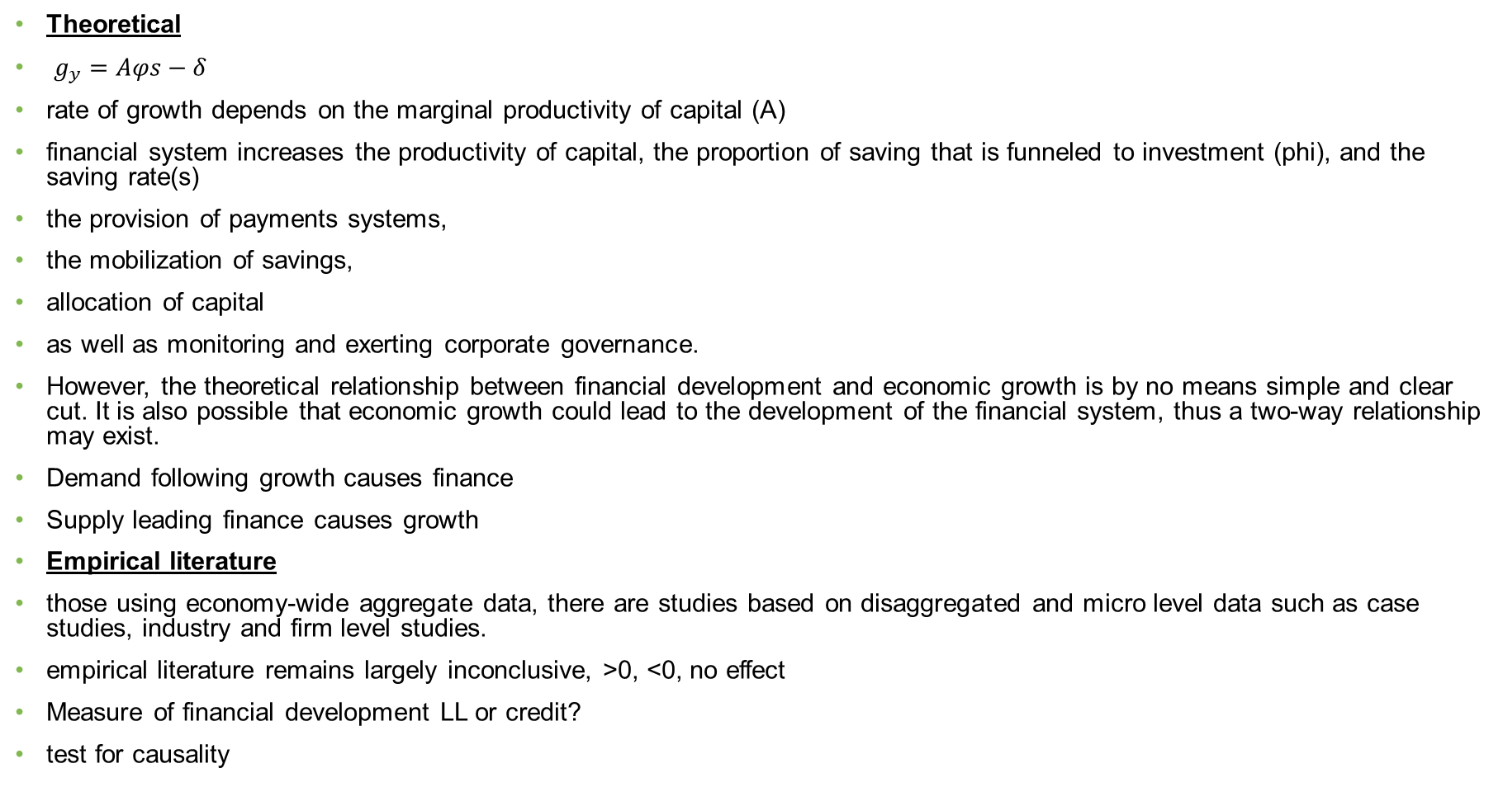
Aziakpono (2011) Theoretical and Empirical
Theoretical
$g_{y}=Aφs−δ$
rate of growth depends on the marginal productivity of capital (A)
financial system increases the productivity of capital, the proportion of saving that is funneled to investment (phi), and the saving rate(s)
the provision of payments systems,
the mobilization of savings,
allocation of capital
as well as monitoring and exerting corporate governance.
However, the theoretical relationship between financial development and economic growth is by no means simple and clear cut. It is also possible that economic growth could lead to the development of the financial system, thus a two-way relationship may exist.
Demand following growth causes finance
Supply leading finance causes growth
Empirical literature
those using economy-wide aggregate data, there are studies based on disaggregated and micro level data such as case studies, industry and firm level studies.
empirical literature remains largely inconclusive, >0, <0, no effect
Measure of financial development LL or credit?
test for causality

Slide 19
LITERATURE REVIEW CLASS EXERCISE
Summarise Ajilore and Ikhide (2012) and Agbloyor et al. (2014) articles in tabular form as per the example provided.
Search for the following article using the databases: Kleimeier, S. & Versteeg, R. 2010. Project finance as a driver of economic growth in low-income countries. Review of Financial Economics, 19, 49-59.
Search for the following article using the databases: Bokpin, G.A. 2017. Foreign direct investment and environmental sustainability in Africa: The role of institutions and governance. Research in International Business and Finance, 39, 239-247.
Summarise the articles in tabular form

Slide 20
LIBRARY DATABASES
ScienceDirect
EBSCOhost
Emerald
If you only use Google Scholar you might miss some of the newer contributions

Slide 21

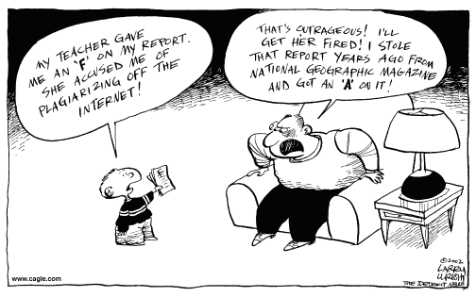
Don’t copy

